Slide 1



relatrio criativo
View in Power BI
Last data refresh:
08/05/2024 18:15:53 UTC
Downloaded at:
08/05/2024 18:51:53 UTC

Slide 2
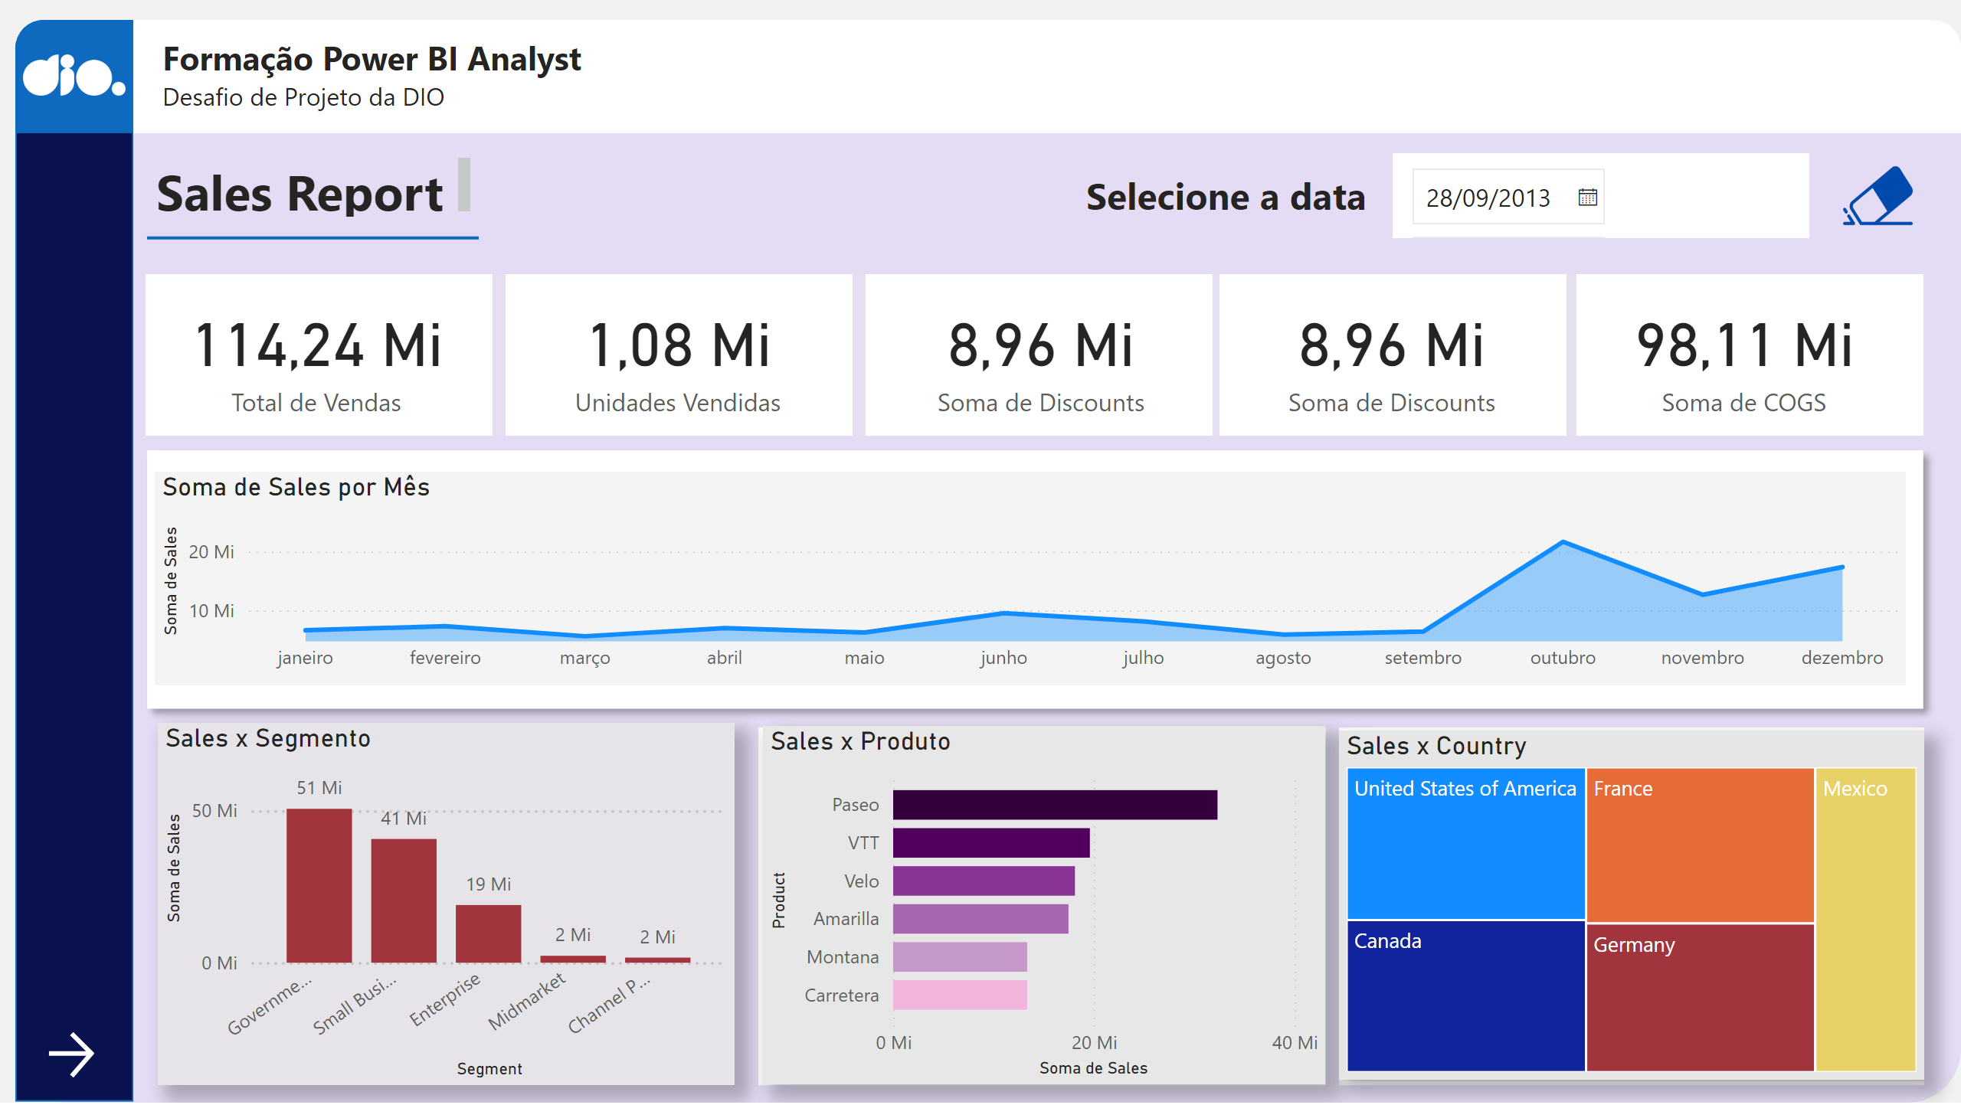
Página 1
Notes:
shape
No alt text provided
shape
No alt text provided
shape
No alt text provided
logo_dio
No alt text provided
shape
No alt text provided
textbox
No alt text provided
card
No alt text provided
card
No alt text provided
card
No alt text provided
card
No alt text provided
card
No alt text provided
shape
No alt text provided
shape
No alt text provided
shape
No alt text provided
shape
No alt text provided
shape
No alt text provided
textbox
No alt text provided
shape
No alt text provided
shape
No alt text provided
clusteredBarChart
No alt text provided
Sales x Segmento
No alt text provided
shape
No alt text provided
shape
No alt text provided
areaChart
No alt text provided
Sales x Produto
No alt text provided
clean
No alt text provided
actionButton
No alt text provided
textbox
No alt text provided
slicer
No alt text provided
Sales x Country
No alt text provided
Sales x Country
No alt text provided
actionButton
No alt text provided

Slide 3
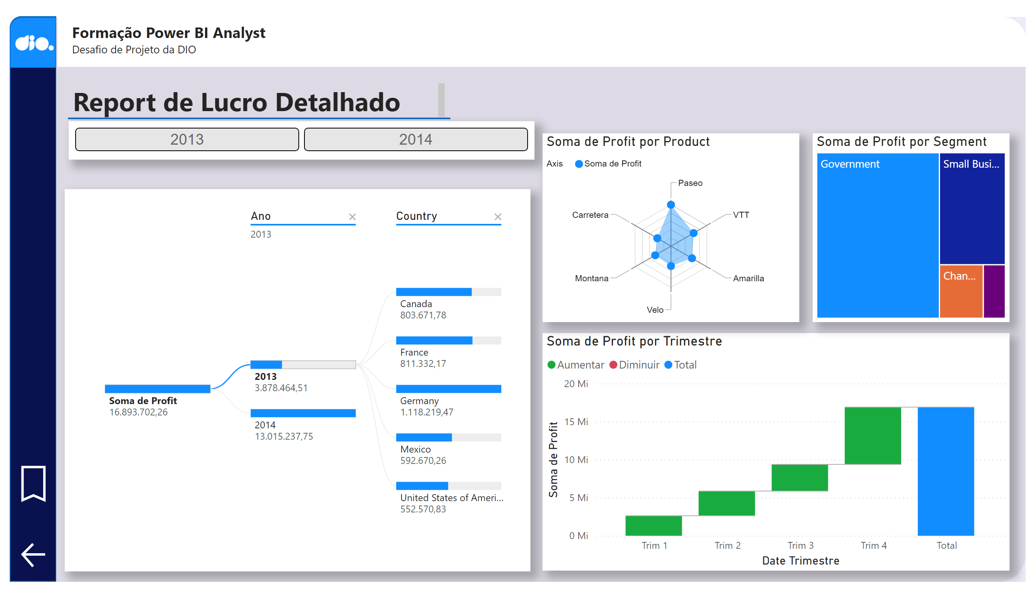
Página 2
Notes:
shape
No alt text provided
shape
No alt text provided
shape
No alt text provided
image
No alt text provided
Fundo do Título
No alt text provided
Título do report
No alt text provided
shape
No alt text provided
decompositionTreeVisual
No alt text provided
waterfallChart
No alt text provided
ChicletSlicer1448559807354
No alt text provided
RadarChart1446119667547
No alt text provided
treemap
No alt text provided
actionButton
No alt text provided
textbox
No alt text provided
shape
No alt text provided
actionButton
No alt text provided

Slide 4
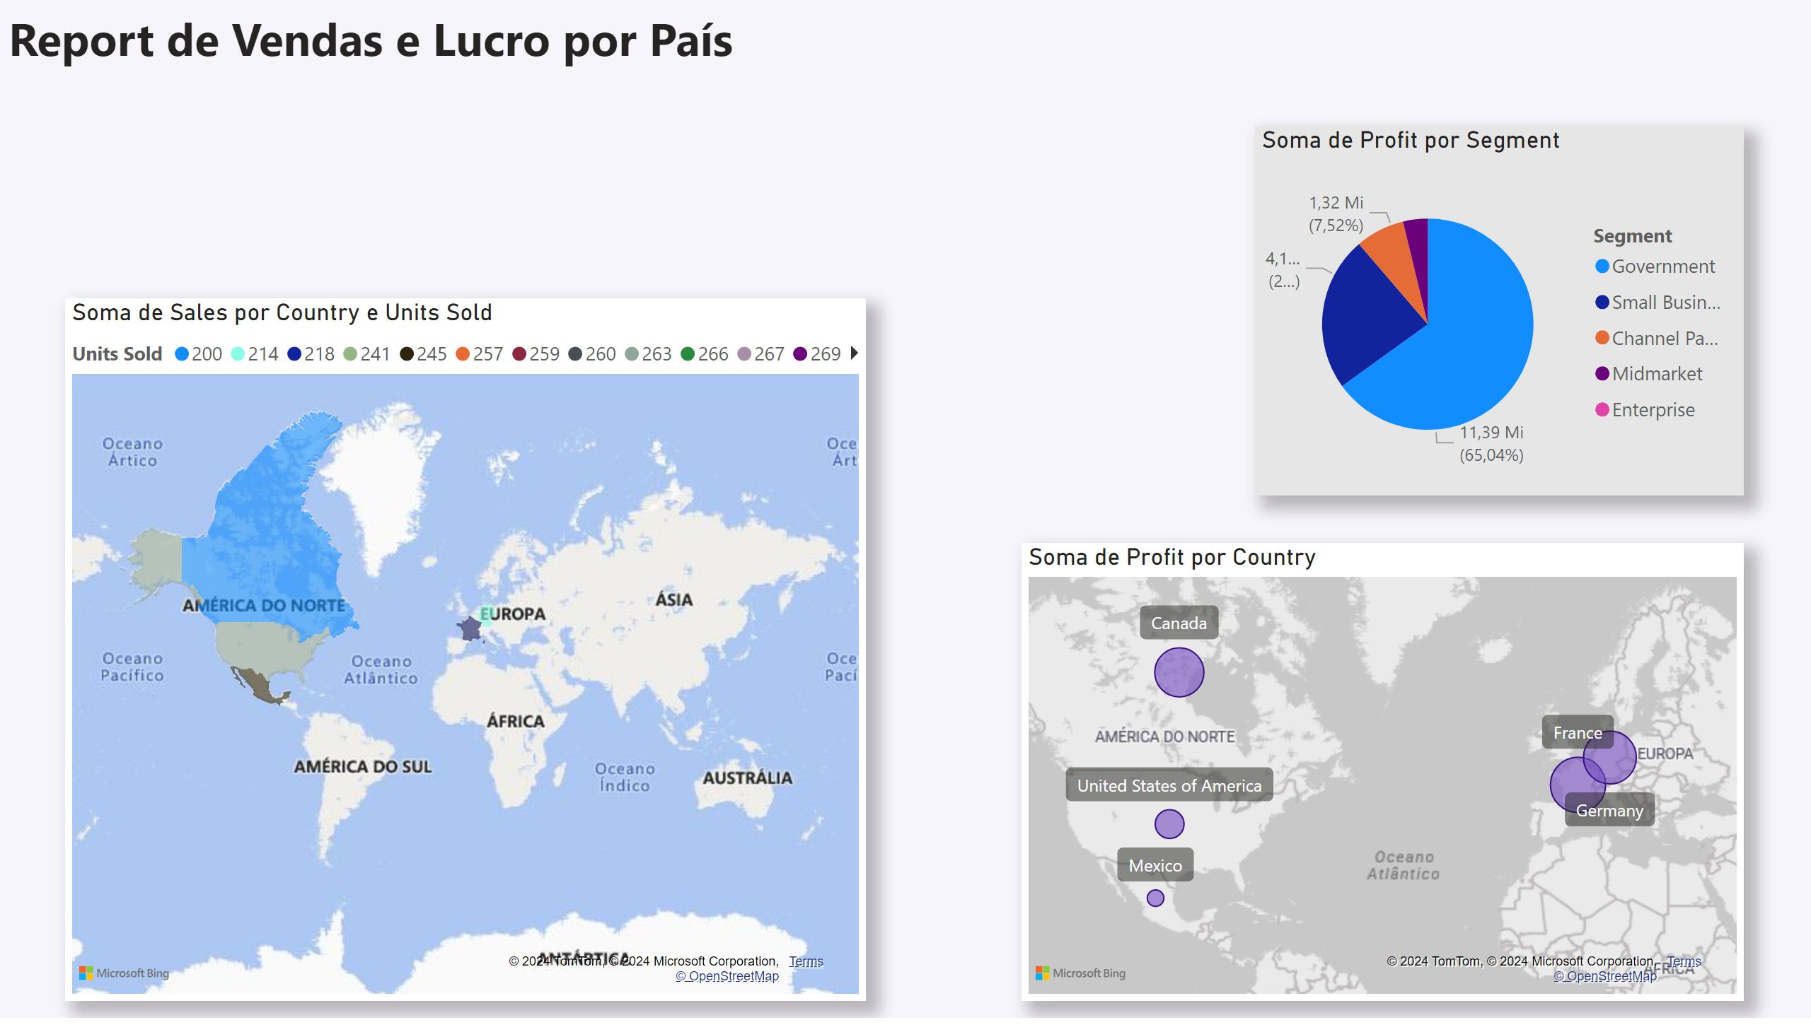
Página 3
Notes:
pieChart
No alt text provided
filledMap
No alt text provided
map
No alt text provided
textbox
No alt text provided

